Slide 1

The most interesting training that i ever had.

Slide 2
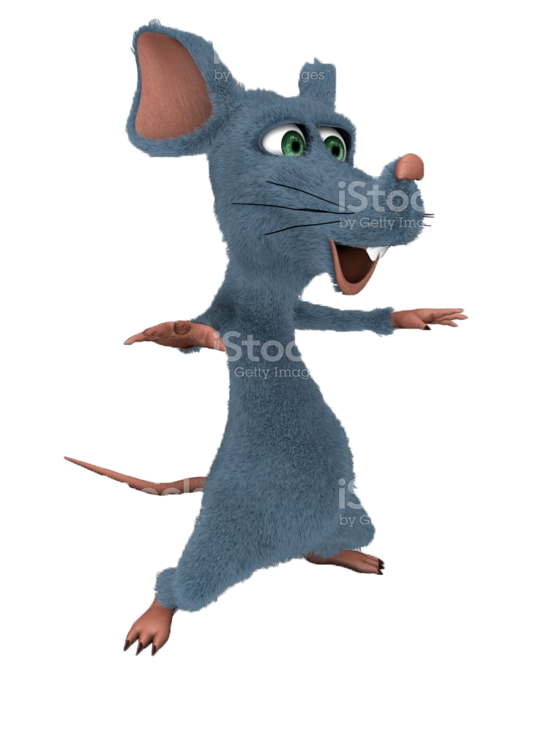
Positive thinking training
One day I attended a positive thinking training that was about how to stay positive and think about positive things
The entire training was conducted by a person called funky Jim and his pet rat called Cheese McPositiv
It was being held in a quite big conference room and very many people were attending it
The room was covered in positively related decorations and it looked very nice and it was easy to relax in

Slide 3
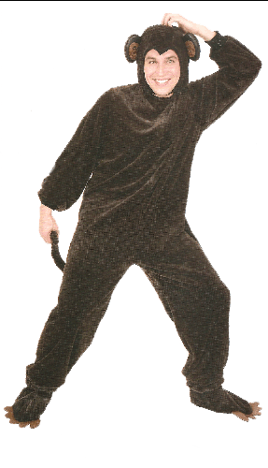

The monkey coach
Funky Jim was in a monkey costume which made everybody laugh and made their mood better
Jim told us about how positive thinking makes a positive inpact on our workflow and productivity
He explained how being positive in a office makes everyone inside a room better at communicating and makes their work twice as fast

Slide 4
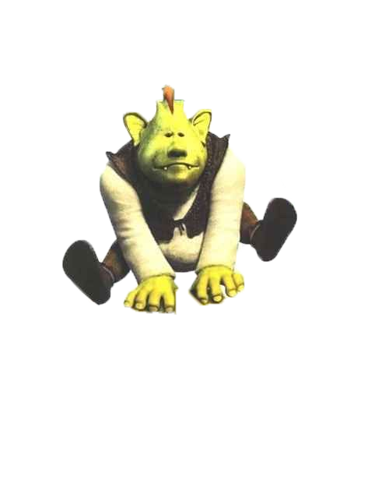
Big green ogre
The coach made many shrek jokes and tried to make everyone think of positive things
Some were funny and some were a bit unfunny but the training in the end was quite fun and made me realise many important things about about how being positive inpacts our work

Slide 5
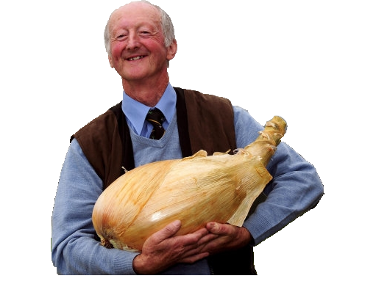
Later that day
Productivity in our office that day was almost doubled and everyone was happy for whole work day
So i guess this positivity traning was pretty succesfull

Slide 6


Quite a good day
That day we made almost dubled our pay and made our boss happy
And ever since that day we kept on our positivity and became better at our tasks
Some of us even got a pernament raise and or a promotion so yeah it was a good training

